Slide 1
STYLEASY : RENT WEAR SWAP
Group Members – Rina Panchbhai (220343120089)
Rushikesh Atalkar (220343120092)
Shruti Patil (220343120073)
Gaurav Kalal (220343120034)
Project Guide – Mrs. Harshita Maheshwari

Slide 2
Contents:-
Introduction
Choice of topic
Proposed System
Methodology
Proposed System Model
Proposed Approach
Screenshot
System Requirements
Applications
Advantages & Limitations
Conclusion
Future Scopes
References

Slide 3
Introduction:-
Styleasy project is all about renting the clothes.
This web application allows customers to rent dresses online.
This project will solve the problem of buying expensive clothes and not been used later.
It will include clothes for all men, women and children.
This is a great way to save money on clothes that you only wear once.

Slide 4
Choice of topic:-
This idea of the app is actually really cool since nowadays, with all the Instagram fast fashion many people just need an outfit for one photoshoot and then they will never wear it again.
Through this project the customer will be able to rent clothes.
The customer also will able to give his clothes for rent.

Slide 5
Proposed System:-
AIM:-
This project will solve the problems of customers buying expensive clothes and not been used later.
Proposed System:-
Easily accessible.
Provide variety of clothes at minimum price.
Rent clothes online.

Slide 6
Methodology:-
The objective is to create a web site that can perform the following:-
Connecting to an HTTPS site through WIFI.
Opening the relevant HTML page using HTTPS POST & GET methods.
Read the data logically into customer and admin.
Creating a local database.

Slide 7
Proposed System Model:-
There are three main modules:-
Admin :
Order List
All Products
Customer Details
Feedback
Log Out
Customer :
Category
Own clothes
My orders
Feedback
Log Out

Slide 8
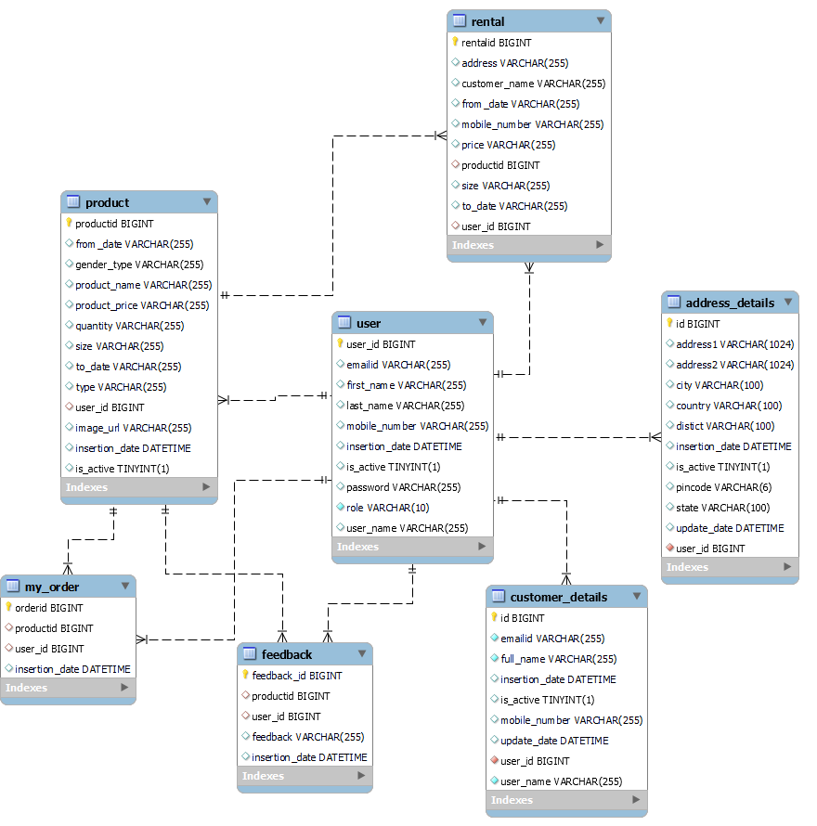
Proposed Approach:-

Slide 9
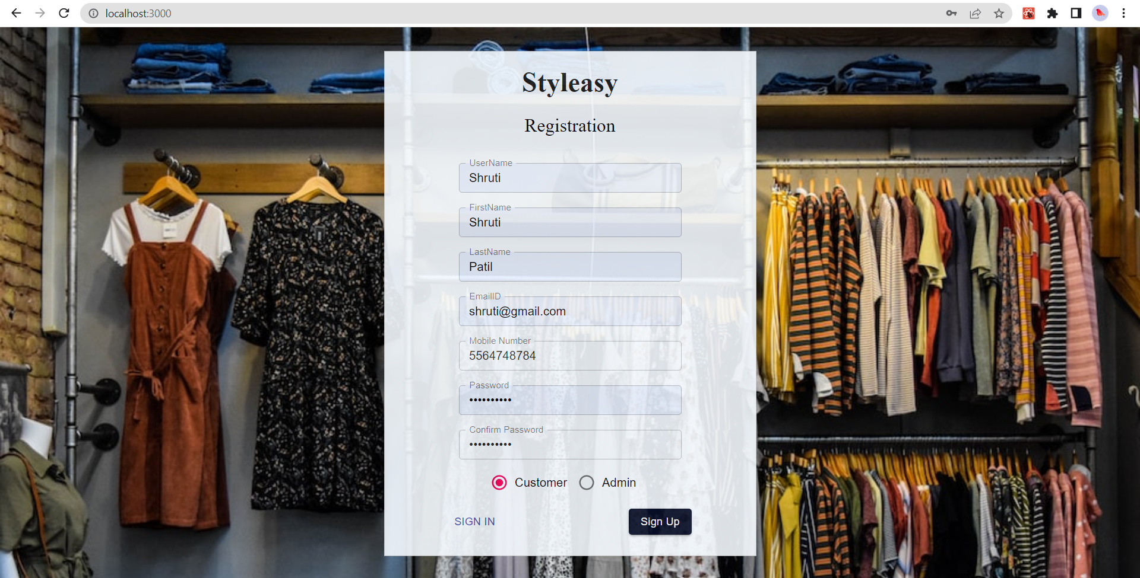
Screenshots:-

Slide 10
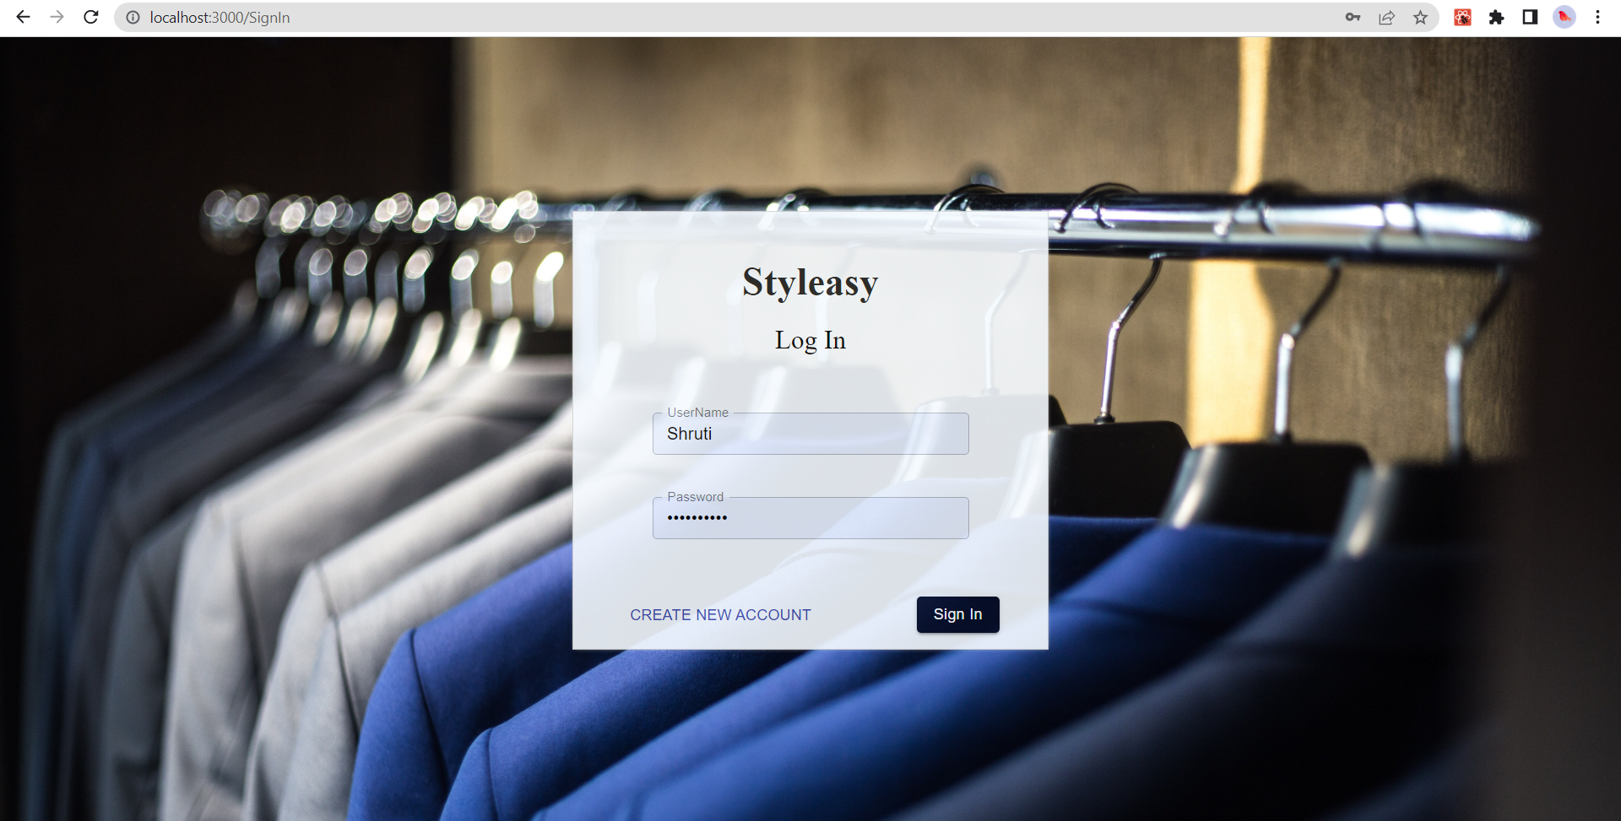

Slide 11
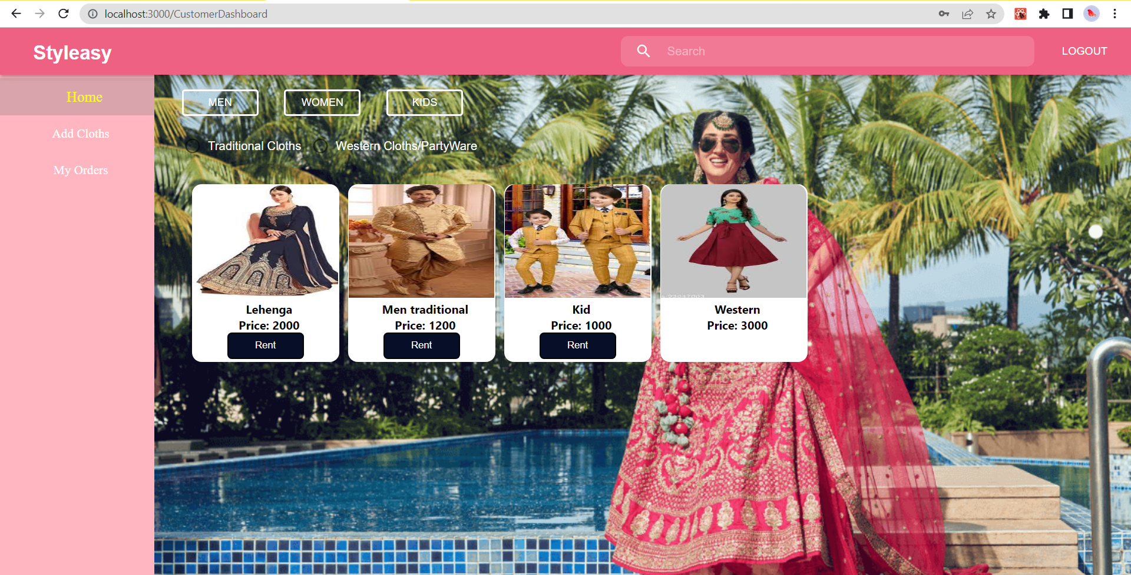

Slide 12
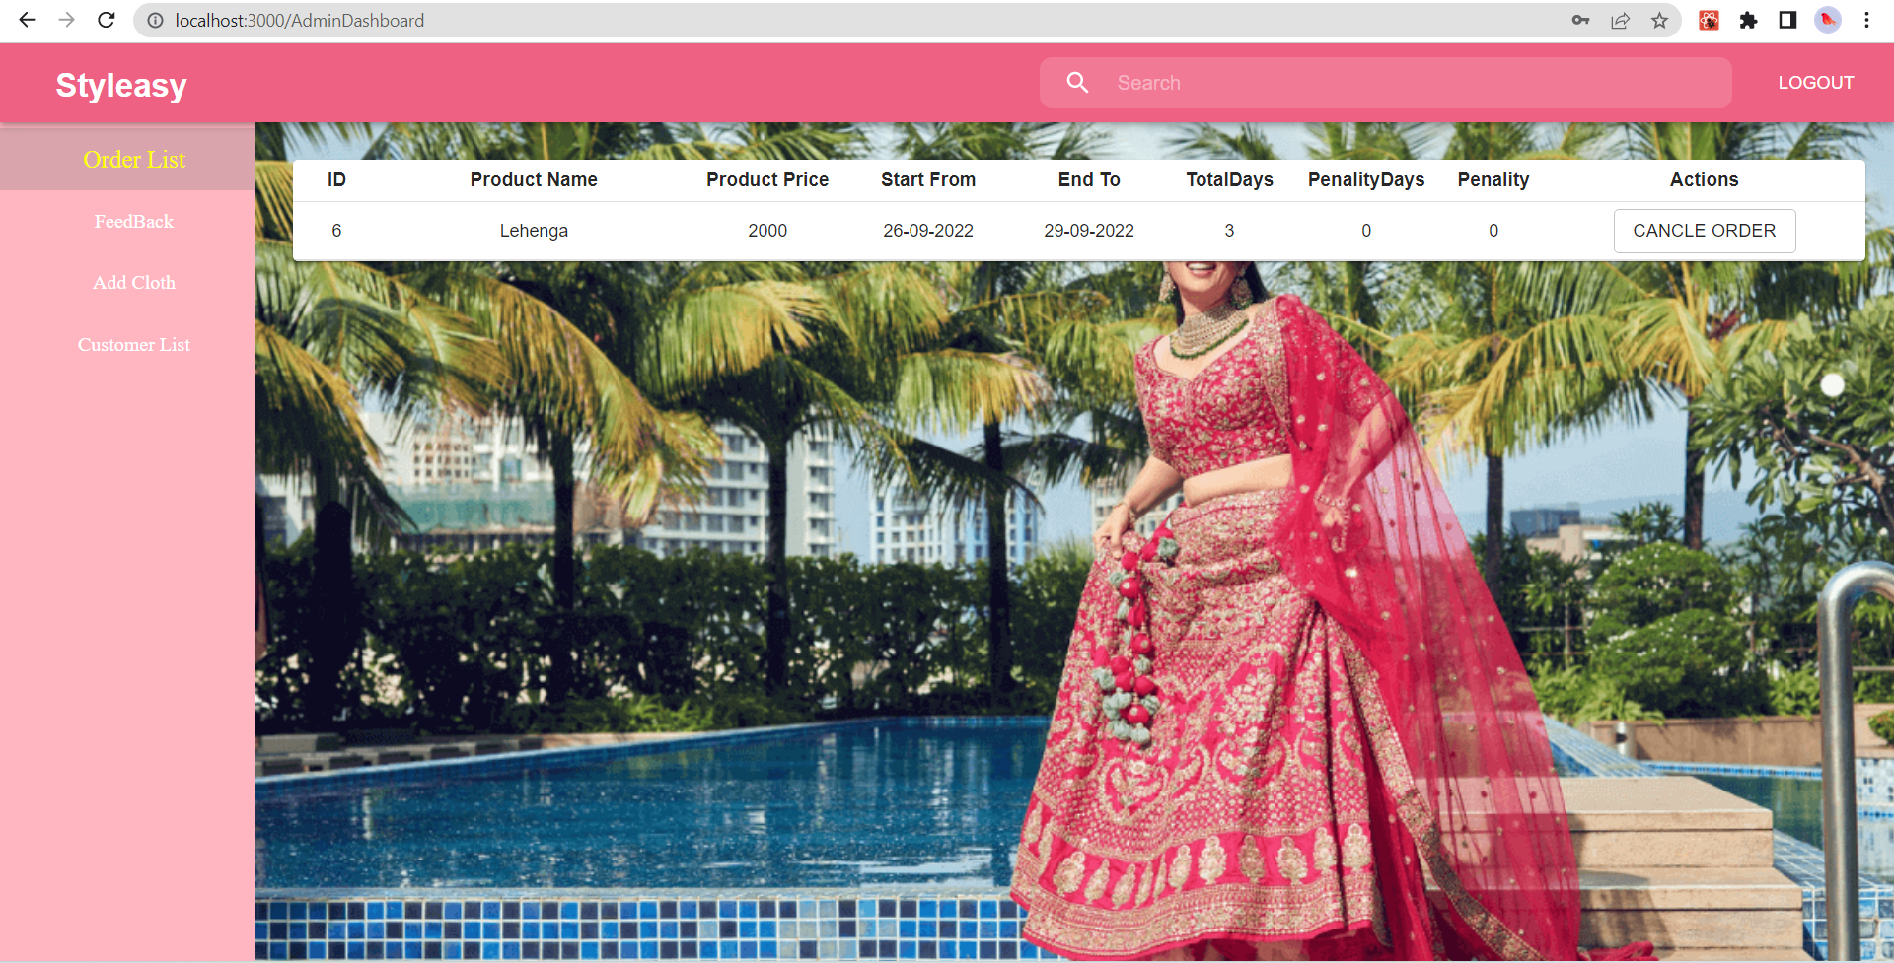

Slide 13
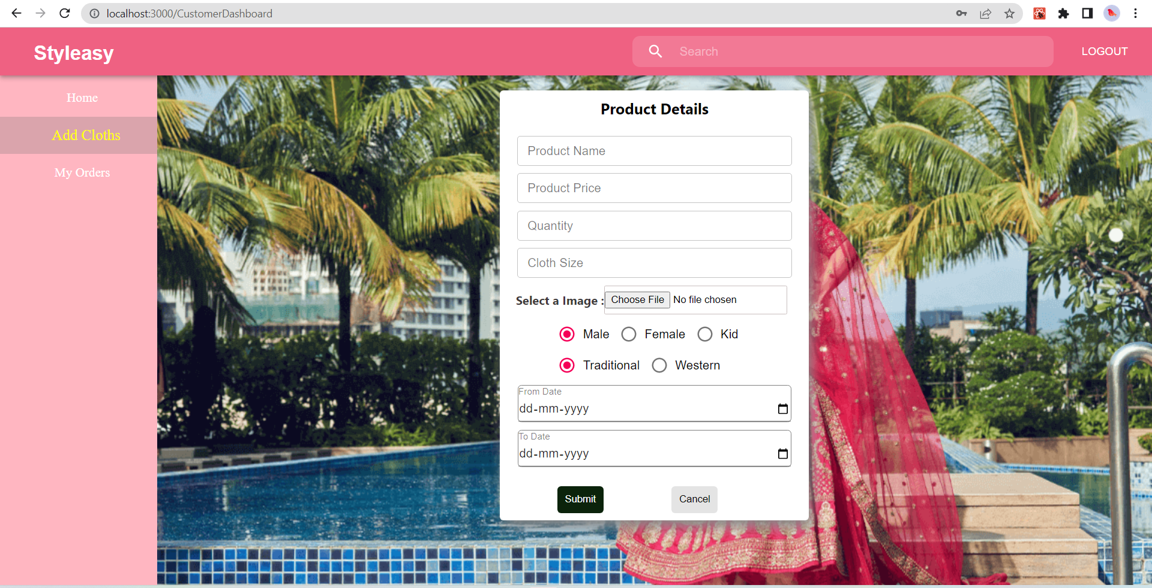

Slide 14
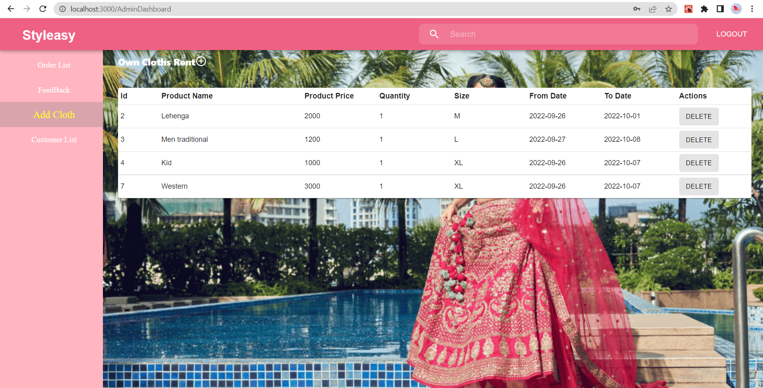

Slide 15
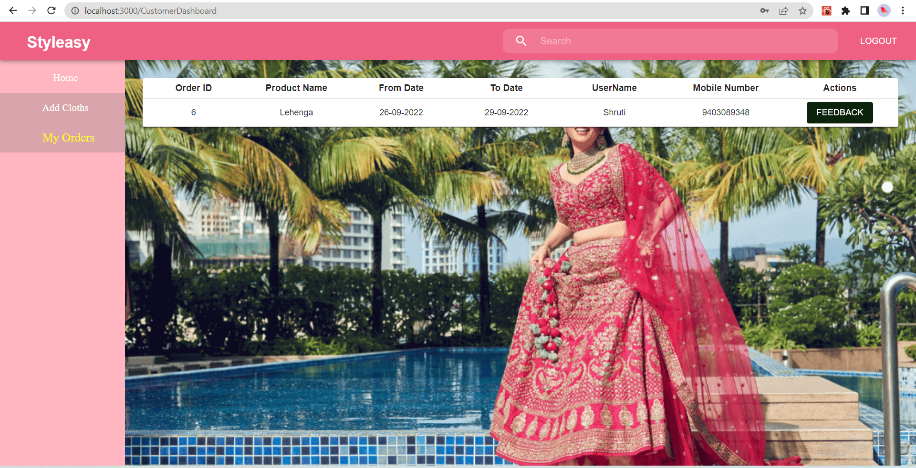

Slide 16
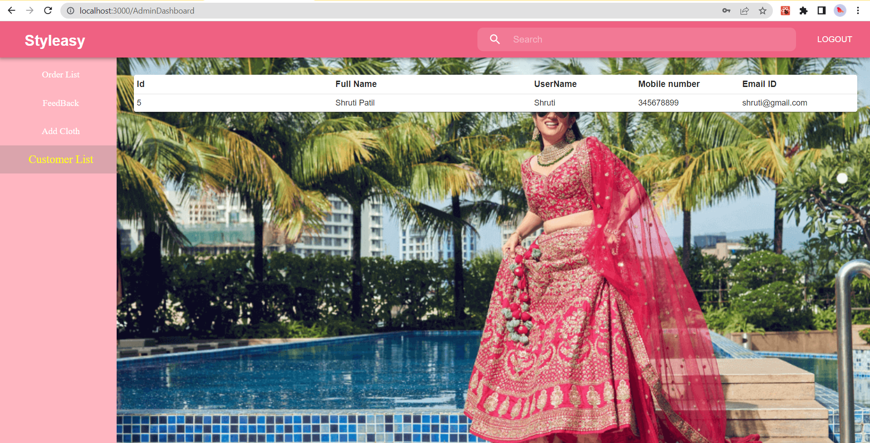

Slide 17
System Requirements:-
Software Requirements:-
Windows (All Versions)
Tomcat 8.5
Eclipse, MySQL, VS Code
Hardware Components:-
Processor – i5
Hard Disk – 500 GB
Memory – 4 GB RAM

Slide 18
Technologies Used:-
React Js : Page Layout has been designed in React Js.
CSS : Used for all designing part.
JavaScript : All Validation task and animations has been developed by JS.
JAVA : All the business logic has been written in JAVA.
MySQL : MySQL database has been used as database.
Tomcat : Project will run using Tomcat server.

Slide 19
Applications:-
Online shopping.
Can be used to rent clothes.
E-commerse website.

Slide 20
Advantages:-
You get to choose from a wide variety of styles and designs.
It will include clothes for all men, women and children.
Great way to save money on clothes that you only wear once.
Consumer is provided with a cloth rental facility.

Slide 21
Limitations:-
Accurate verification of the users cannot be done online.
It requires an extensive database and memory.

Slide 22
Conclusion:-
The Styleasy cloth rental application is designed and developed to provide cloth rental facility to the customer. Customers will have an easy interface where they will rent dresses. And, customers will rent these dresses. It will help both the customer and the owner of the dress store. Customers can rent one or more dresses of their choice, make payments online and get them delivered to their doorstep. This is a great way to save money on clothes that you only wear once. Lastly it can be improved in future according to rising demand of users.

Slide 23
Future Scope:-
Verification of users.
Improvement in design.
Mobile Application.
We can add more products to rent such as jewelleries and bags.
Chat BOT .

Slide 24
References:-
Mr. Saleel Bagde for Database.
Mrs. Harshita Maheshwari for React JS & CSS also she was our project guide.
Mrs. Mayuri Fakirpure for JAVA.
https://www.slideshare.net
https://www.projectideas.co.in
https://codebun.com/
A special thanks to Infoway Management who arranged extra lab time for us.

Slide 25
THANK YOU !

